Slide 1
Online Bookstore System
YUAN GAO
JIAN ZHANG
ANQI TIAN

Slide 2
Introduction
Analysis Model
Design Class Diagram
Sequence Diagrams
Design Patterns Utilized

Slide 3
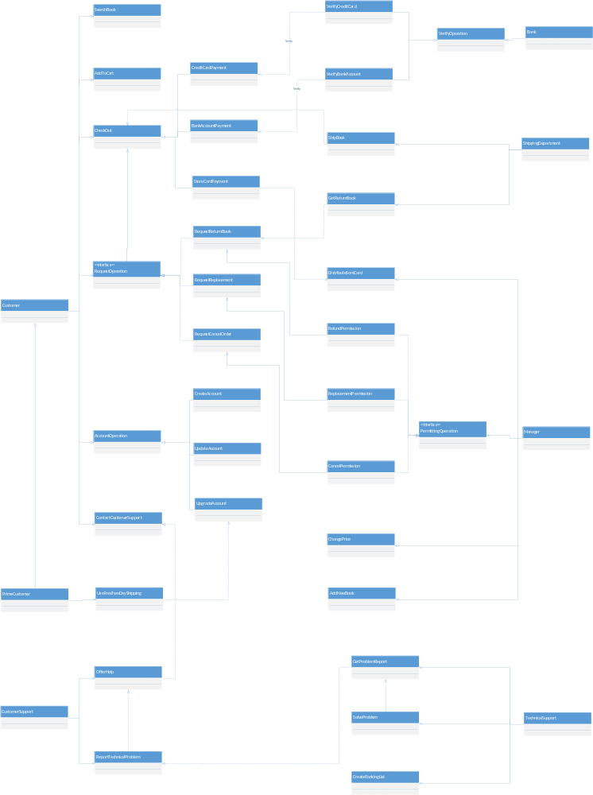
Analysis Model

Slide 4
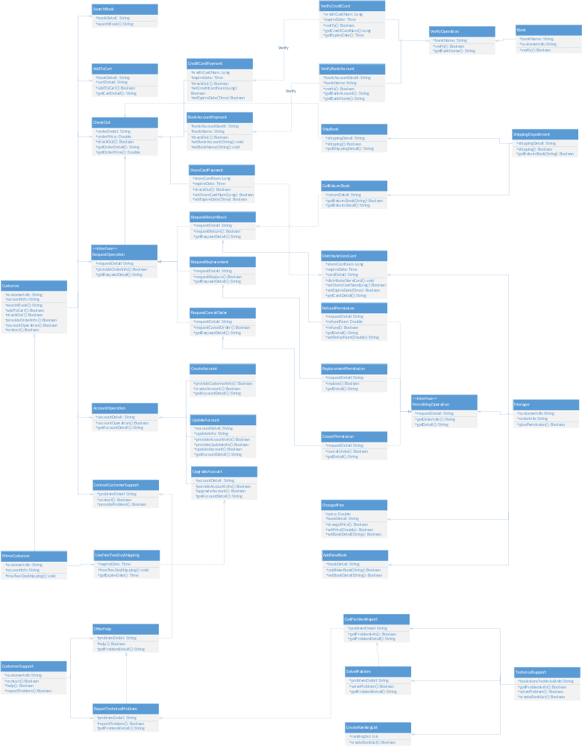
Design Class Diagram

Slide 5
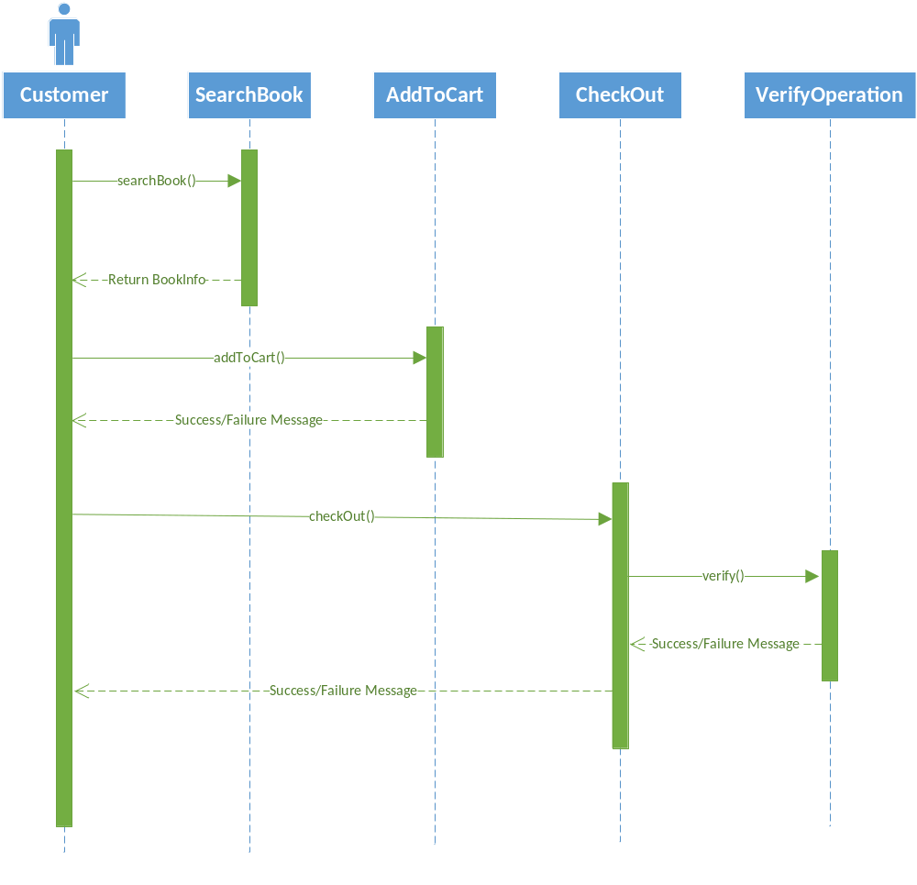
Sequence Diagram：
Customers Buy Book

Slide 6
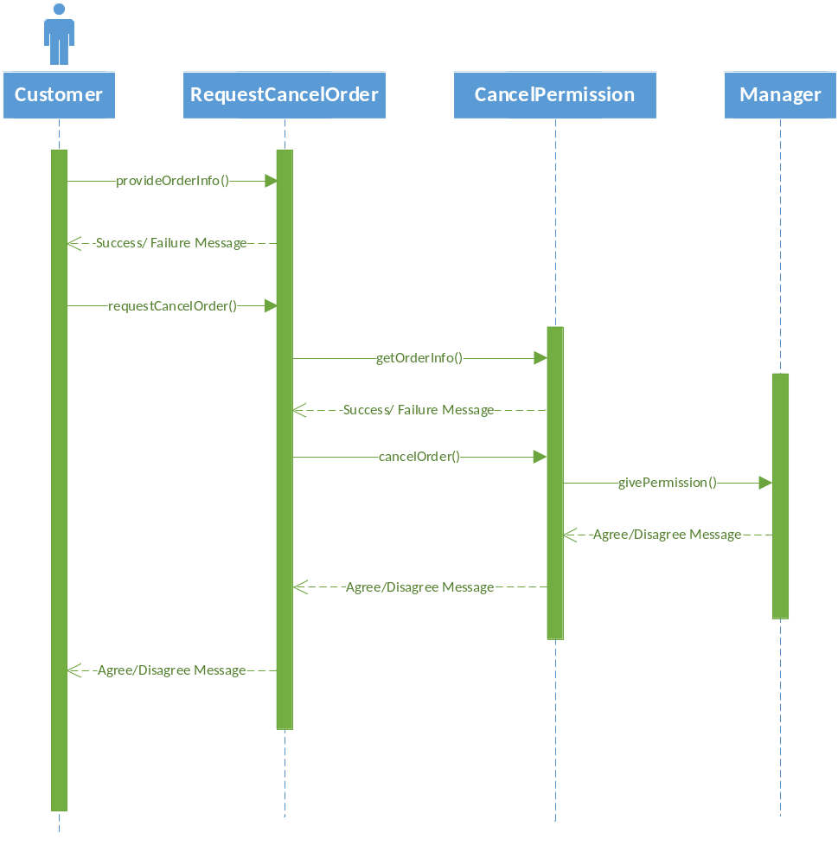
Sequence Diagram：
Customers Cancel Order

Slide 7
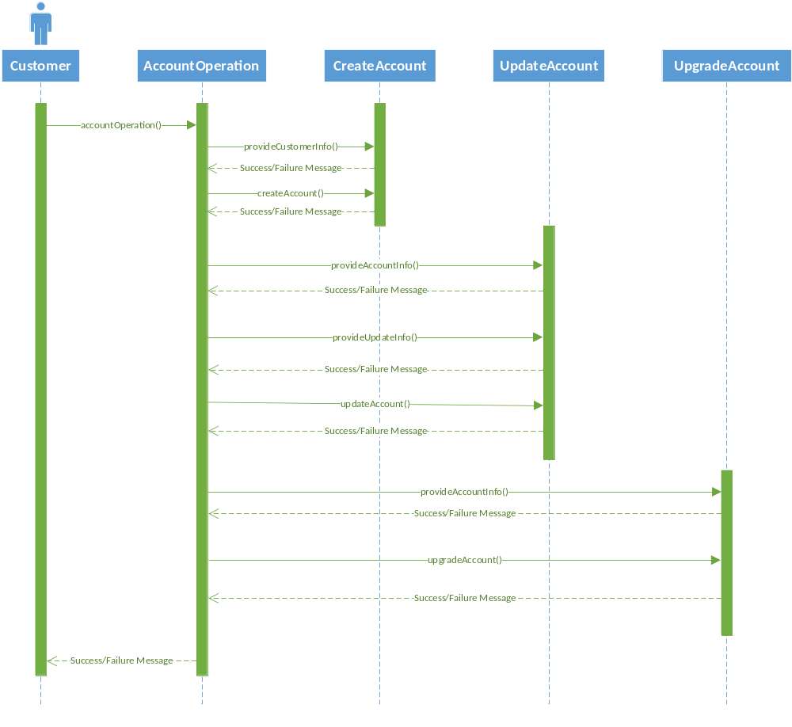
Sequence Diagram：
Customer Account Operation

Slide 8
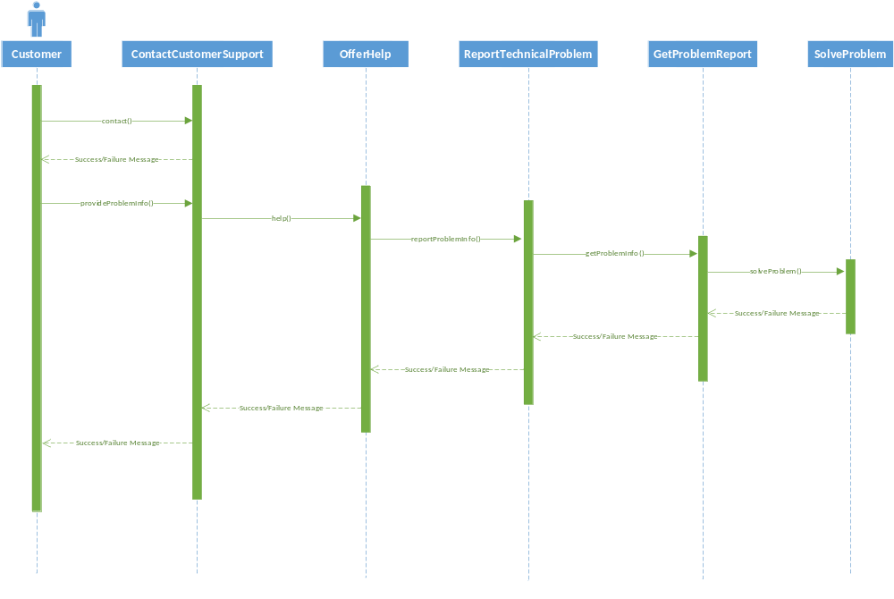
Sequence Diagram：
Customers Get Technical Help

Slide 9
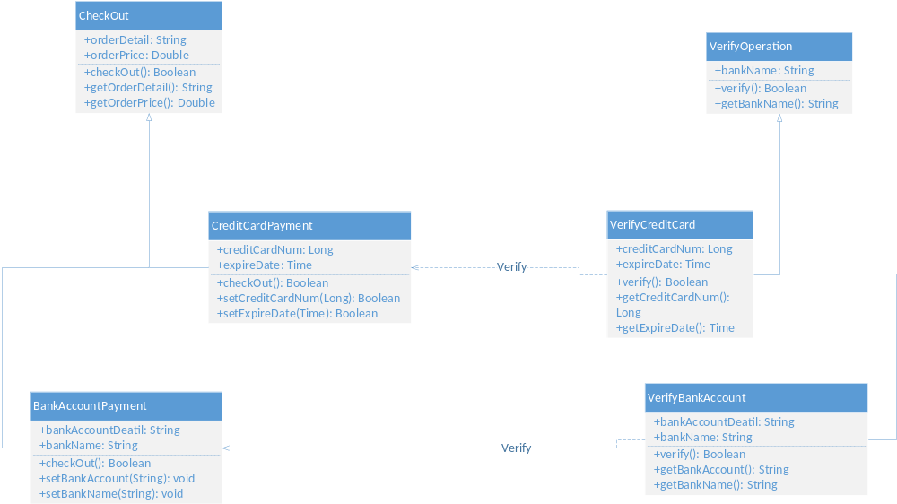
Design Pattern: Factory Method

Slide 10
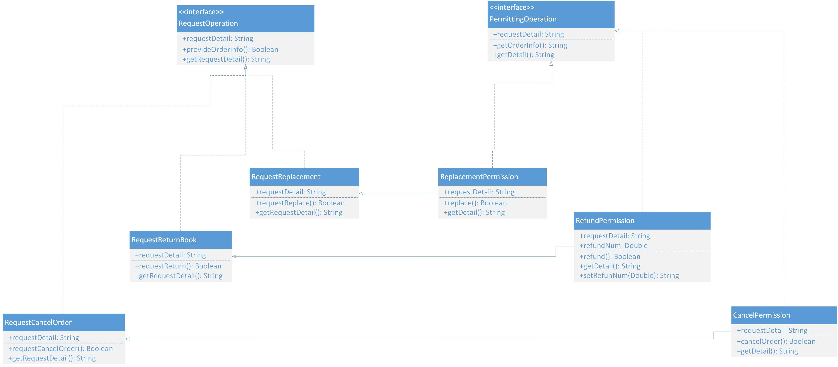
Design Pattern: Abstract Factory

